Slide 1


LESSON 6
INVERSE TRIGONOMETRIC FUNCTIONS

Slide 2

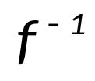
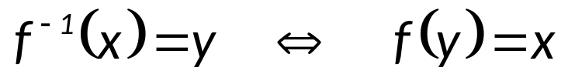
INVERSE TRIGONOMETRIC FUNCTION
Definition: If is a one-to-one function with domain A and range B, then its inverse is the function with domain B and range A defined by
For a function to have an inverse, it must be one-to-one. Since the trigonometric functions are not one-to-one, they do not have inverses. It is possible, however, to restrict the domains of the trigonometric functions in such a way that the resulting functions are one-to-one.

Slide 3


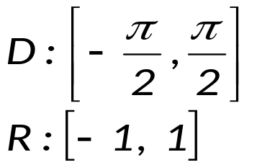

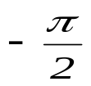




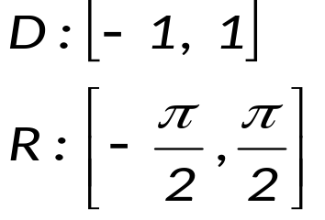
INVERSE TRIGONOMETRIC FUNCTIONS ARE DEFINED AS FOLLOWS:
y
o
x
y = sin x
y
o
x
y = sin⁻¹ x
Notes:
plane

Slide 4
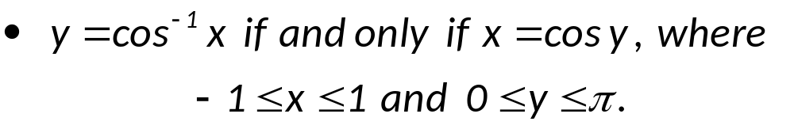
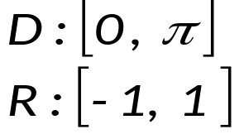

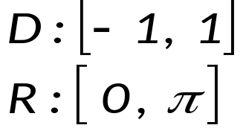
y
o
x
y = cos x
y
x
o
y = cos⁻¹ x
Notes:
plane

Slide 5
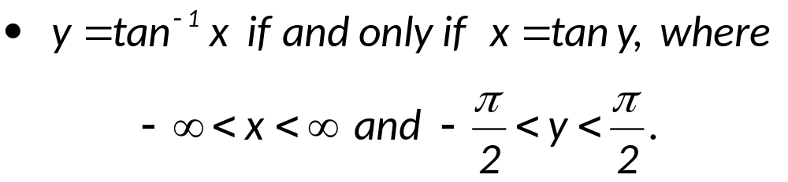
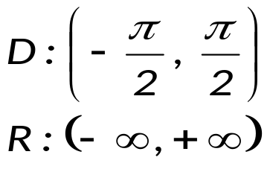
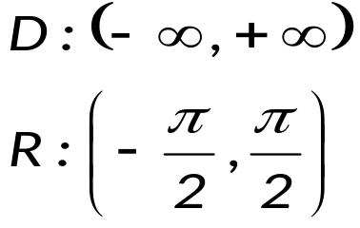
y
o
x
y = tan x
y
x
o
y = tan⁻¹ x
Notes:
plane

Slide 6
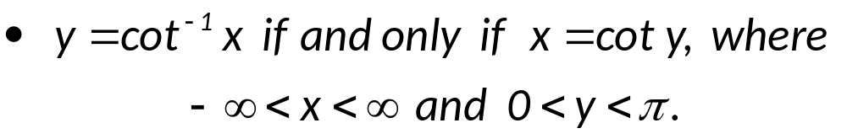
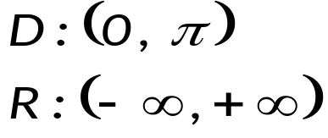
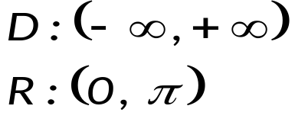
y
o
x
y = cot x
y
o
x
y = cot⁻¹ x
Notes:
plane

Slide 7
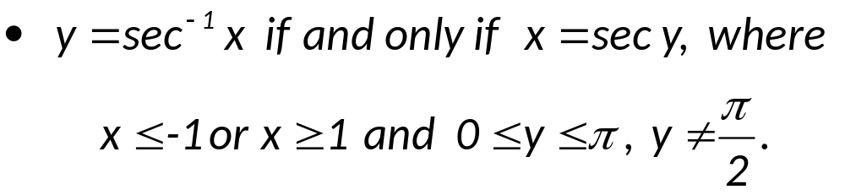
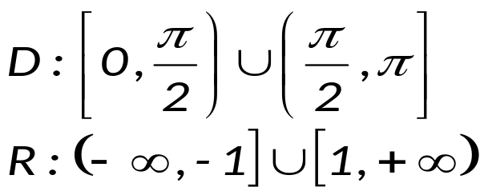



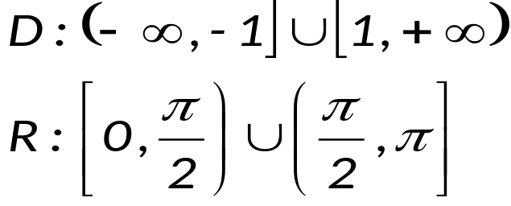
y
o
x
y = sec x
y
o
x
y = sec⁻¹ x
Notes:
plane

Slide 8
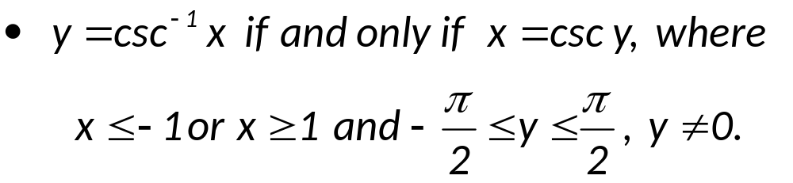
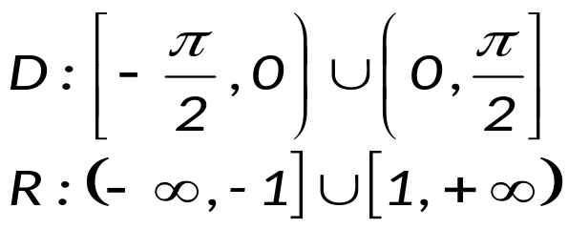




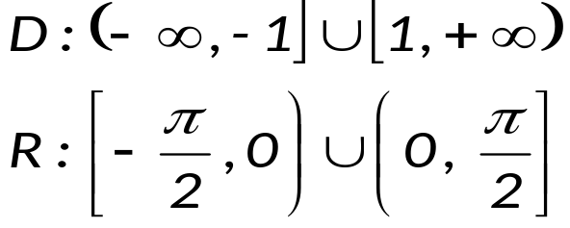

y
o
x
y = csc x
y
o
x
y = csc⁻¹ x
Notes:
plane

Slide 9


Summary of the domain and range of each inverse functions
Inverse Function | Domain | Range
y = sin ^{–1} x | [–1, 1] | [–π/2, π/2]
y = cos ^{–1} x | [–1, 1] | [0, π]
y = tan ^{–1} x |  | (–π/2, π/2)
y = cot ^{–1} x |  | (0, π)
y = sec ^{–1} x |  | [0, π/2) U (π/2, π]
y = csc ^{–1} x |  | [–π/2, 0) U (0, π/2]

Slide 10
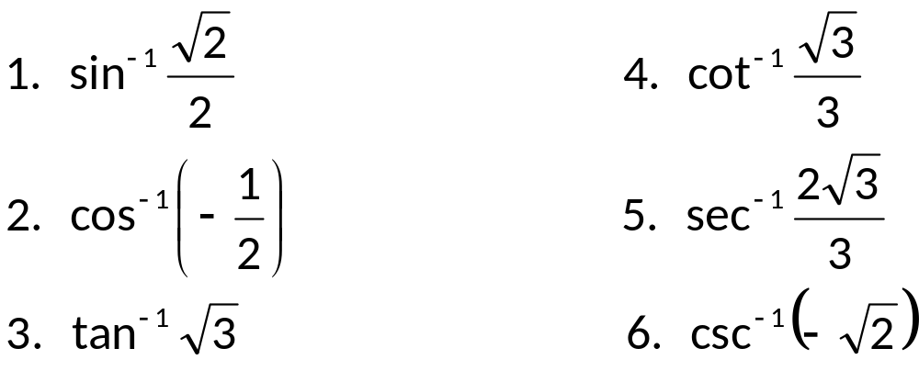
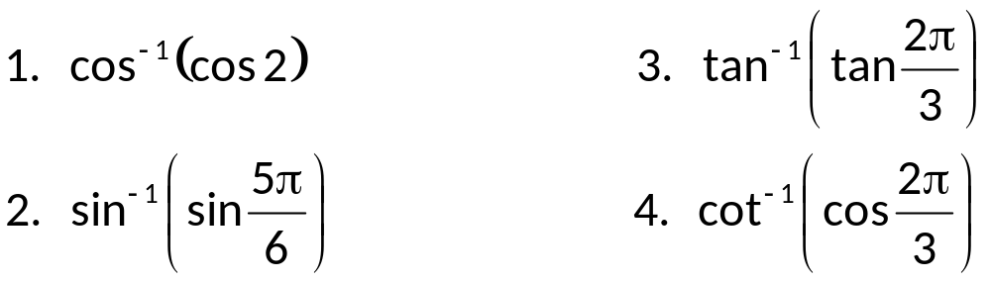
EXAMPLES
I. Find the exact radian value.
II. Find the exact value of the given expression.

Slide 11
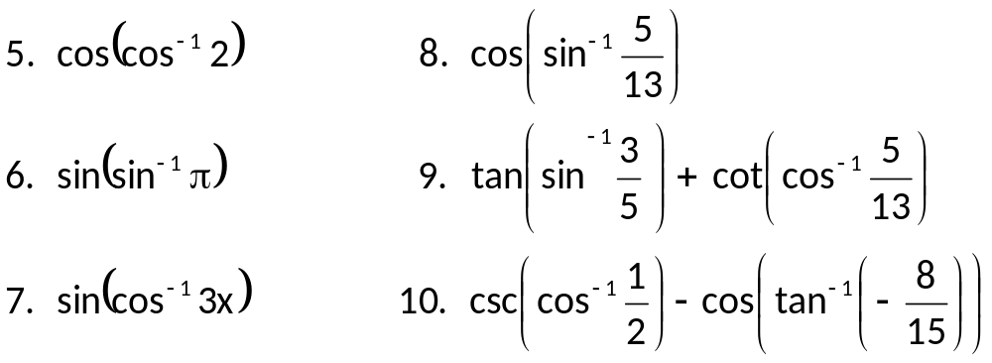
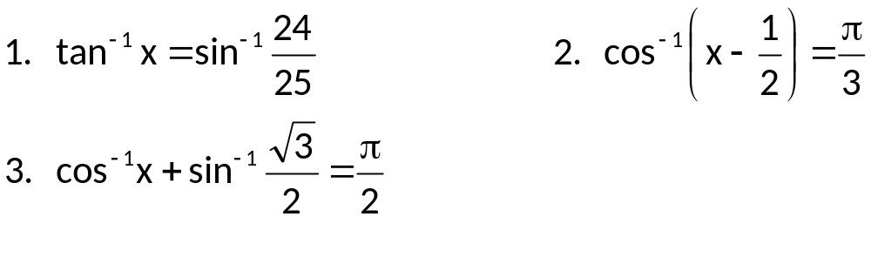
III. Solve the equation for x algebraically.

